Slide 1
The Use of Force by Private Security Companies
Mark Blaine

Slide 2
Contents
Introduction
Selected Definitions
Creating Use of Force Policy
General Principles of the Use of Force
General principles of Self Defence
Use of Force other than Self Defence
Operations in the Land Environment
Reporting and Recording Incidents
Private Security in the Maritime Domain
Conclusion

Slide 3
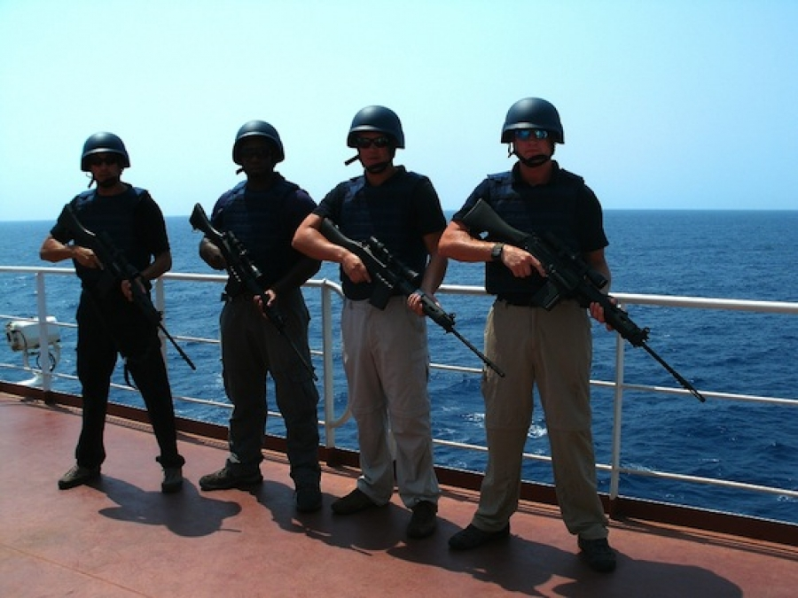
1. Introduction
PSC play a crucial role in providing a wide range of services to
  Governments
  NGO’s
  Private Corporations
  Individuals
May need to use force to persons and/or property
Such force need to comply with laws applicable to individuals and also to geographical area
  Need clear guidelines
  Need good training (realistic and scenario driven)
Guidelines on the high seas are challenging
  Overlapping jurisdiction

Slide 4
Selected Definitions
Private Security Company (PSC)
  Any private sector company whose business activities include protecting people, property, and information, conducting investigations, and otherwise safeguarding an organisation’s assets.
Privately Contracted Security Personnel (PCSP)
  Persons employed (through direct hire or under some other form of contractual relationship) whose duties include the carriage and/or control of weapons and the use of force
Privately Contracted Armed Security Personnel (PCASP)
  Persons employed in the maritime domain (through direct hire or some other form of contractual relationship with a shipping or associated company) whose security duties include the carriage and/or control of weapons and the use of force aboard or from vessels
Flag State
  The State of registry or licence of a vessel
Home State
  The State of nationality of a client, a PSC, PCSC, PCASP
Territorial State
  The State in which a PSCP is located at a given time

Slide 5
Selected Definitions and Abbreviations
National Waters
  Waters subject to the territorial sovereignty of Coastal States (include internal waters, territorial seas and archipelagic waters
International Waters
  Waters to seaward of the territorial seas
Team Leader
  A member of the assigned PSC team designated by the contractor as Team Leadewr, and identified as such to the appropriate authorities
UoF
  Use of Force
Deadly Force
  Force that is intended or likely to cause death, or serious injury, regardless of whether death or serious injury results
Excessive Force
  Any force that is not reasonable and necessary to deter, neutralise or stop a threat

Slide 6
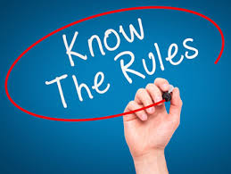
2. Creating Use of Force Policy
UoF policies to be developed as part of planning process
Identifies the circumstances and limitations that govern the use of force by PSC
Need to be approved by a competent authority (could be national governments)
Legal parameters of UoF Policy
  Comply with ALL laws and regulations of ALL jurisdictions to be encountered
  Cannot interfere with the right to self defence
  Not a blanket immunity to clients or PSC
Annex A in handbook provides a menu for UoF policies
Checklist for Creation of UoF Policy
  Analyse contract
  Analyse security environment
  Analyse risks
  Determine levels of force that may be required
  Analyse applicable legal regimes
  Analyse limitations on the use of force
  Assess problem areas
  Prepare the draft UoF policy
  Approval
  Distribution

Slide 7
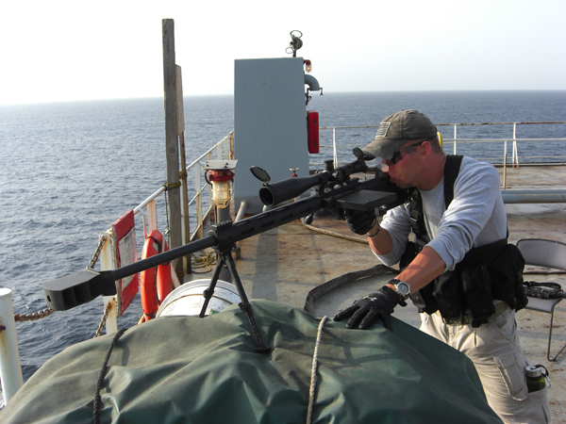
3. General Principles of the UoF
Two primary categories of force in any operation
  Deadly force
  Non-deadly force
Use only force which is reasonable and necessary to
  Deter
  Neutralise
  Stop the threat
See examples on page xii and xiii
Any use of force has legal consequences
Retaliation is prohibited (after attack is deterred, neutralised or stopped)
All reasonable effort to be made to not use force
Warning shots only authorised when permitted by applicable laws

Slide 8

4. General Principles of Self Defence
Two categories
  Individual Self-defence
  Defence of Others
Self defence must be proportionate to the threat
No UoF policy can restrict the right to self defence
The extent of the right or obligation to protect others will differ from jurisdiction to jurisdiction
Command and Control
PSC personnel must comply with direction of the on-scene authority

Slide 9
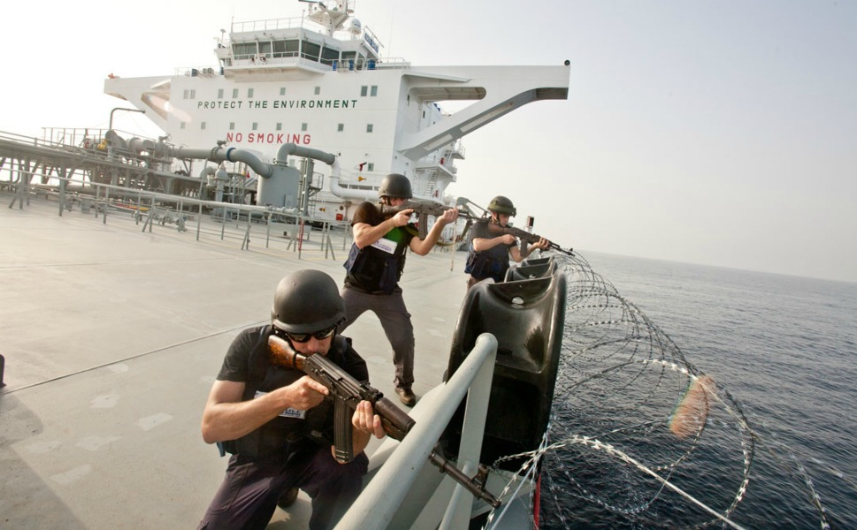
5. Use of Force other than Self Defence
PCSP to use only force as authorised by the UOF policy
Only non-deadly force to be used to defend property
Exception such as dams, nuclear power stations, ammunition storages, etc

Slide 10
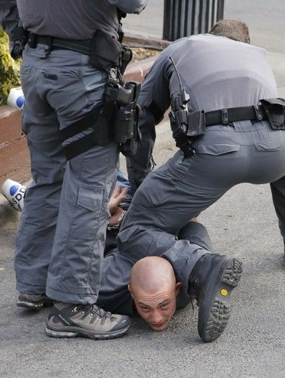
6. Operations in the Land Environment
Mostly Access Control
Restraining/apprehending people. Minimum requirements:
  Length of apprehension
  Initial actions
  Treatment
  Conditions of apprehension
  Monitoring
  Handover

Slide 11
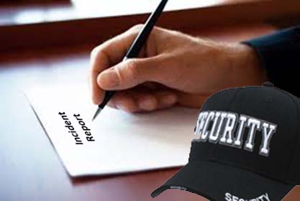
7. Reporting and Recording Incidents
During/after each security incident
  Record the incident
    Provide record
    Provide lessons learnt
  Report the incident
    Especially when force was used
  Handling and treatment of persons involved
    Where possible evidence should not be disturbed
    Persons to be handed to law enforcement personnel as soon as possible
  Subsequent investigation of the incident

Slide 12
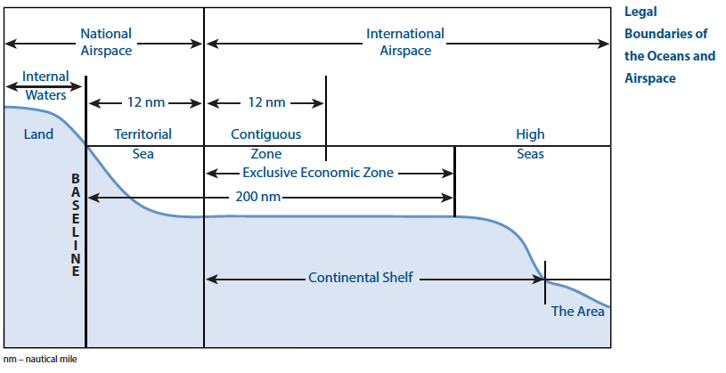
8. Private Security in the Maritime Domain
UNCLOS Maritime Zones

Slide 13
8. Private Security in the Maritime Domain
Territorial Seas
  Up to 12nm
  Coastal state has sovereignty
  Broad prescriptive and enforcement jurisdiction
  Innocent passage by foreign vessels
    No conduct prejudicial to good order, peace and security
    Mere act of carrying weapons not considered prejudicial
    No practice or exercise whilst on innocent passage
    Weapons to be secured below deck
    Transit to roadstead, anchorage may not be considered innocent passage
    Coastal states may restrict or prohibit carrying of arms

Slide 14
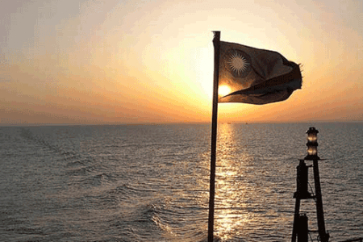
8. Private Security in the Maritime Domain
Contiguous zone
  Up to 24nm
  Coastal States may enforce customs, fiscal, immigration and sanitary laws
  Carriage and display of arms normally permitted
  Some States may restrict possession or carriage or arms
Legal Jurisdiction in Maritime Zones
  Flag state law ALWAYS applies to a ship
  Other laws will apply as ship/persons enter and leave zones of littoral states

Slide 15
8. Private Security in the Maritime Domain
Applicable national Law by Geographic Location

Slide 16

8. Private Security in the Maritime Domain
Command and Control of Vessels
  Masters remain responsible for safety of people, property and objects under their control
  Masters have authority over all persons onboard
  PCASP remain under the authority of the Master
  PSC Team Leader answerable to the Master
  PSC Team Leader and Master to agree in advance on general conditions, requirements and circumstances governing response to and management of use of force incidents
  During security situation, PSC Team Leader to advise the Master of intention to invoke UoF policy
  Each PCASP responsible for own decisions to use force

Slide 17

8. Private Security in the Maritime Domain
Command and Control of Vessels
  Master may order cease fire, but may not limit right of self defence
  Master may direct PCASP to apprehend a person iaw the law
    Must comply with UoF policy
    Master to ensure proper detaining and accommodation
    Action will remain under Flag State and territorial State laws for proper treatment
    Right to apprehend includes right to search individual for security reasons
    Use of restraints may be authorised

Slide 18
9. Conclusion
PSC play a crucial role in providing a wide range of services
Guidelines on the high seas are challenging
Creation and guidance in UoF policies are crucial
General principles for the use of force and in self defence
Important to adequately record and report all incidents
Maritime domain is complex
Master remains in command throughout
Suspects to be treated in accordance with law
Handbook is a great tool for planning and execution

